Slide 1
Analyzing Airbnb and Foursquare data in Berlin
Final Project for IBM Data Science Capstone
Juan Pablo Caro

Slide 2
Introduction
The goal of this project is to provide some guidance about the lodging market in Berlin, and what neigborhoods are best to invest in a Hotel, B&B or Airbnb hosting.

Slide 3
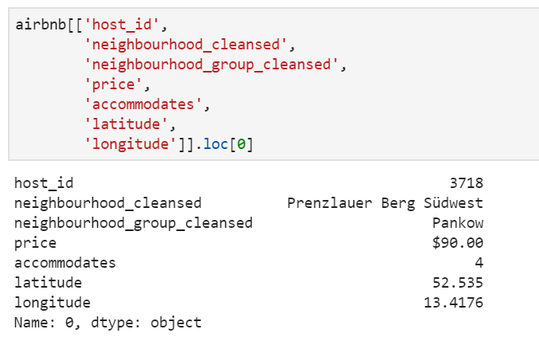
Inside Airbnb
The project Inside Airbnb collects data from the Airbnb database for many cities around the world.
Among the information that it contains, there is relevant information about the neighborhoods of a city, and the location of the hosts.
This data is publicly available in the project website:
http://insideairbnb.com/

Slide 4
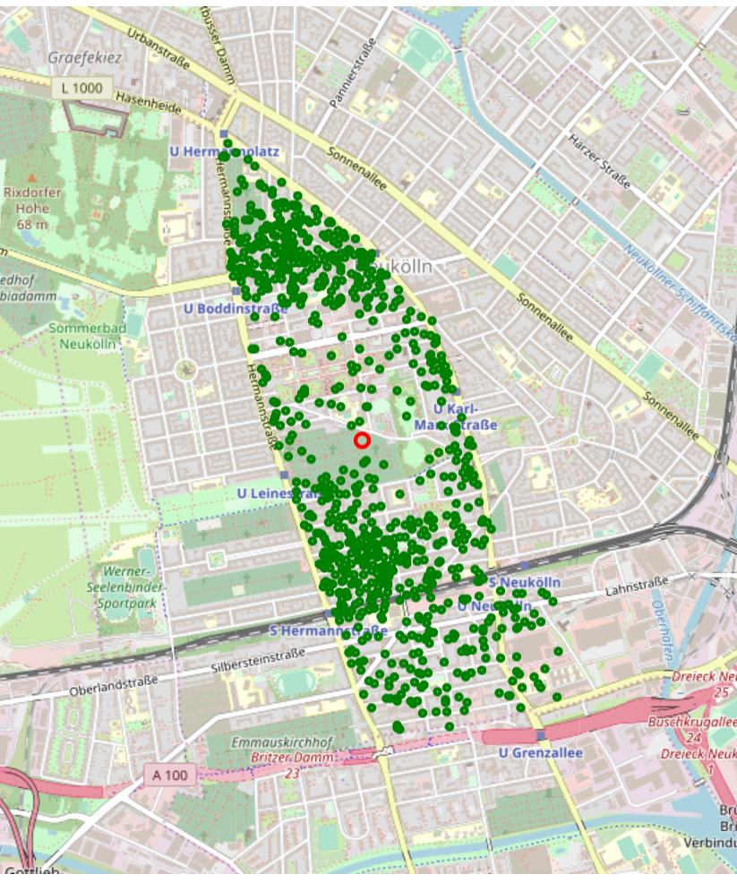
Coordinates for each neighborhood
Using the Airbnb data, I calculated the average coordinates of each neighborhood based on the hosts.
Also, I calculated average price (per person), and the total amount of Airbnb hosts for each neighborhood. (137 in all the city.
Here is an example for Neuköllner Mitte (Center of Neukölln burough).

Slide 5
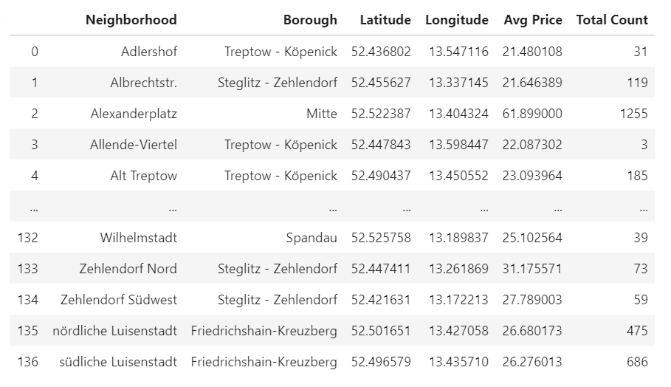
Sample of the calculated coordinates, average price and count of Airbnb hosts

Slide 6
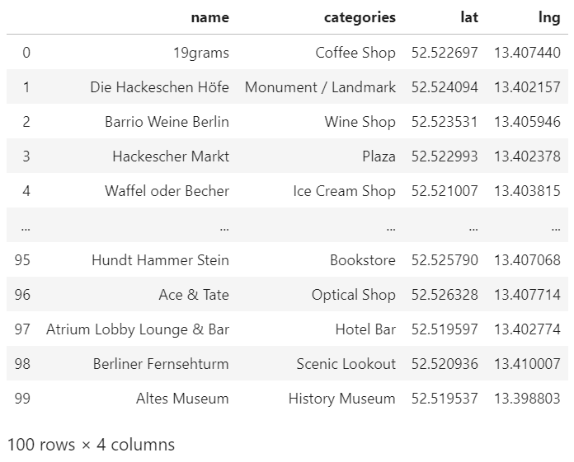
The Foursquare API
Using the Foursquare API, I obtained information about the top 100 venues for each area.
This table shows a sample of the top venues in Alexanderplatz, one of the most crowded and popular areas in Berlin.
Using this data, I calculated the percentage of restaurants and hotels in each neighborhood.

Slide 7
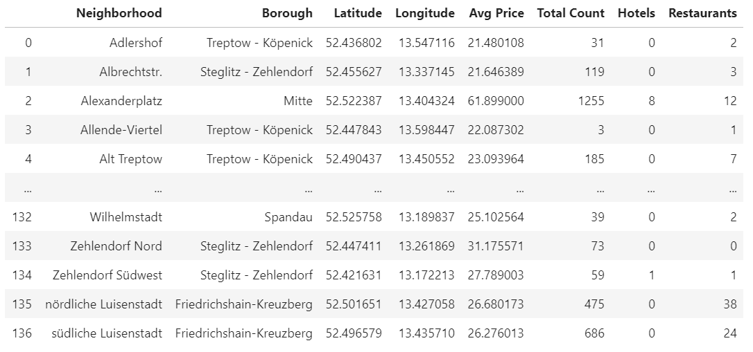
Complete dataset

Slide 8
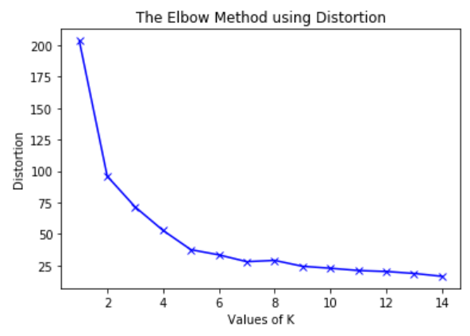
K-Means Clustering
Using K-Means clustering and the elbow method, I calculated the optimal number of categories for clustering the neighborhoods.
The elbow method shows the number of clusters where the quality of the clustering is better, with an “elbow” change in the curve. In this case, this happens when k = 5.

Slide 9
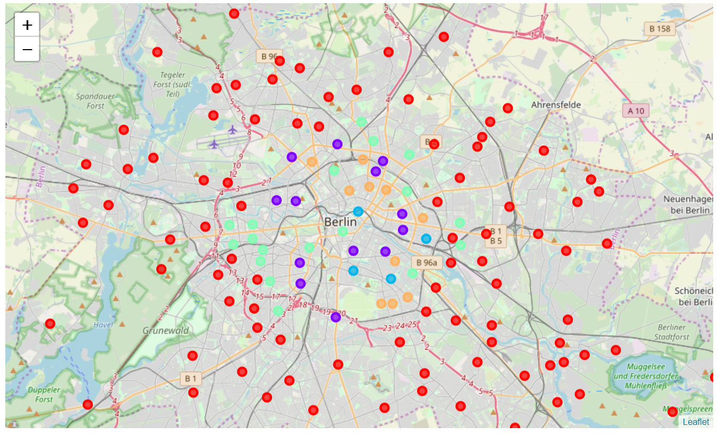
Clusters on a Berlin map

Slide 10
Results
The map shows the geographical distribution of the five clusters I obtained.
An analysis of the data in each one of those clusters, can get us to some conclusions about each one of them, and the lodging market in Berlin.

Slide 11
Results: Cluster 0
In Cluster 0, the amount of venues, restaurants and hotels is quite low, and so is the number of Airbnb hosts. The prices are also slightly lower compared to other clusters, so it might be a bad idea to invest in these neighborhoods. These are the neighborhoodss in the outer city.

Slide 12
Results: Cluster 1
All the neighborhoods in Cluster 1 are well located in the city center, or close to the more crowded neighborhoods. Also, they have a nice amount of venues and facilities, and the Airbnb offer is not as big as in clusters 2 and 4. This is definitely a market worth looking at.

Slide 13
Results: Cluster 2
Cluster 2 contains the most crowded neighborhoods, including Alexanderplatz and Frankfurter Allee Süd. However, the prices for Alexanderplatz are considerably higher compared to other neighborhoods in the same cluster and with more or less the same offers. It might be interesting to invest in one of these neighborhoods, depending on the housing costs.

Slide 14
Results: Cluster 3 and 4
Cluster 3 is more disperse across the city, and seem to include more residential areas. These neighborhoods are probably not so interesting for an investment.
Cluster 4 is slightly more crowded than Cluster 2, and doesn't seem to have as many restaurants. However, some of the neighborhoods are very well located in touristic places, like the ones in Friedrichsain-Kreuzberg or Neukölln.

Slide 15
Analyzing Airbnb and Foursquare data in Berlin
Thanks!

